Slide 1
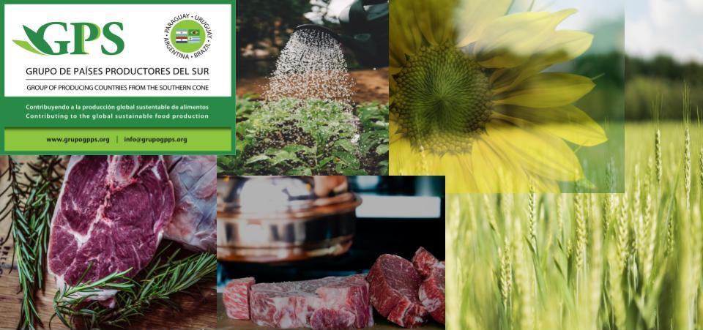

Food Security, Trade and Climate Change.
Global Political Challenges
London, October 2019
Horacio Sánchez-Caballero
Martín Fraguío

Slide 2

MISSION:
  GPS IS A NETWORK ESTABLISHED IN 2013 OF PRIVATE INSTITUTIONS FROM URUGUAY, PARAGUAY, BRAZIL AND ARGENTINA ACTING IN THE FIELD OF FOOD SECURITY
  SEEKING TO CONTRIBUTE TO THE INTEGRATION OF THE SOUTHERN CONE COUNTRIES AND THEIR INTERNATIONAL PROJECTION BY:
ARTICULATING between the institutions in order to position relevant issues related to agro industry with a strategic vision of the world and the region.
GENERATING CONTENTS and providing information and analysis on issues of interest to GPS promoting the public-private dialogue within and among ABPU. (50 documents published)
SPREADING information and ideas through the promotion, organization and participation in national, regional and international forums to contribute to the international positioning of the region.

Slide 3
AREAS OF DEVELOPMENT
GEOPOLITICS OF FOOD
REGIONAL INTEGRATION IN ARGENTINA, BRAZIL, PARAGUAY AND URUGUAY (ABPU).
AGRIBUSINESS INTERNATIONAL DEVELOPMENT, TRADE AND INVESTMENT.
CLIMATE CHANGE AND AGRICULTURAL BEST PRACTICES.

Slide 4
SOUTHERN CONE CONTRIBUTIONS TO FOOD SECURITY AND GLOBAL ENVIRONMENTAL SUSTAINABILITY
Uruguay, Paraguay, Brazil and Argentina have a land area that is second to Russia on a global scale.
The challenge of achieving food security is complex since climate change and natural resource sustainability should be considered.
The Southern Cone has a proven track record of innovations to increase food production based on sustainable production systems.
Smooth global food trade should facilitate food security and natural resource sustainability.
The Southern Cone has a valuable experience of “sustainable intensification” that could be an interesting alternative to most world production systems that are deteriorating natural resources and contributing excessively to global warming.
Notes:
7
7
7
It covers practically 2/3 of the region´s land area.
Its GDP is just under u$s 800 billion - 53% of the regions total.
Its total trade (exports plus imports) reached 146 billion dollars in 1995.
65% of U.S. foreign direct investment in South America is in the MS countries. Brazil is the largest recipient of U.S. FDI in L.A. (including Mexico). Brazil u$s 19,0 billion and Mexico u$s 16,3 billion (1994 figures).
In other words, Mercosur is an integrated market which accounts for more than half the value of Latin America´s main economic indicators, and has a unmistakable potential and drawing power.
Chile has just concluded a Free Trade Agreement with MS, which will open further avenues for growth in trade and investments.

Slide 5
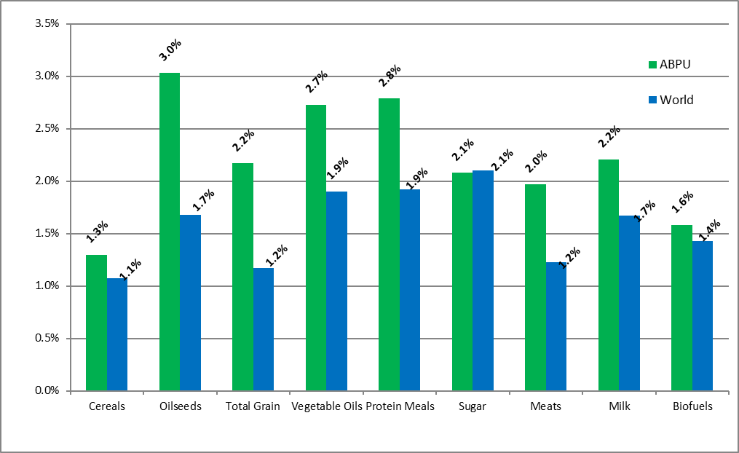
TOTAL WORLD AND ABPU COUNTRIES PRODUCTION PROJECTIONS.
SELECTED PRODUCTS. 2015-2024
(annual growth rates in %)
Source: FAO-OCDE Outlook; INAI
Notes:
7
7
7
It covers practically 2/3 of the region´s land area.
Its GDP is just under u$s 800 billion - 53% of the regions total.
Its total trade (exports plus imports) reached 146 billion dollars in 1995.
65% of U.S. foreign direct investment in South America is in the MS countries. Brazil is the largest recipient of U.S. FDI in L.A. (including Mexico). Brazil u$s 19,0 billion and Mexico u$s 16,3 billion (1994 figures).
In other words, Mercosur is an integrated market which accounts for more than half the value of Latin America´s main economic indicators, and has a unmistakable potential and drawing power.
Chile has just concluded a Free Trade Agreement with MS, which will open further avenues for growth in trade and investments.

Slide 6
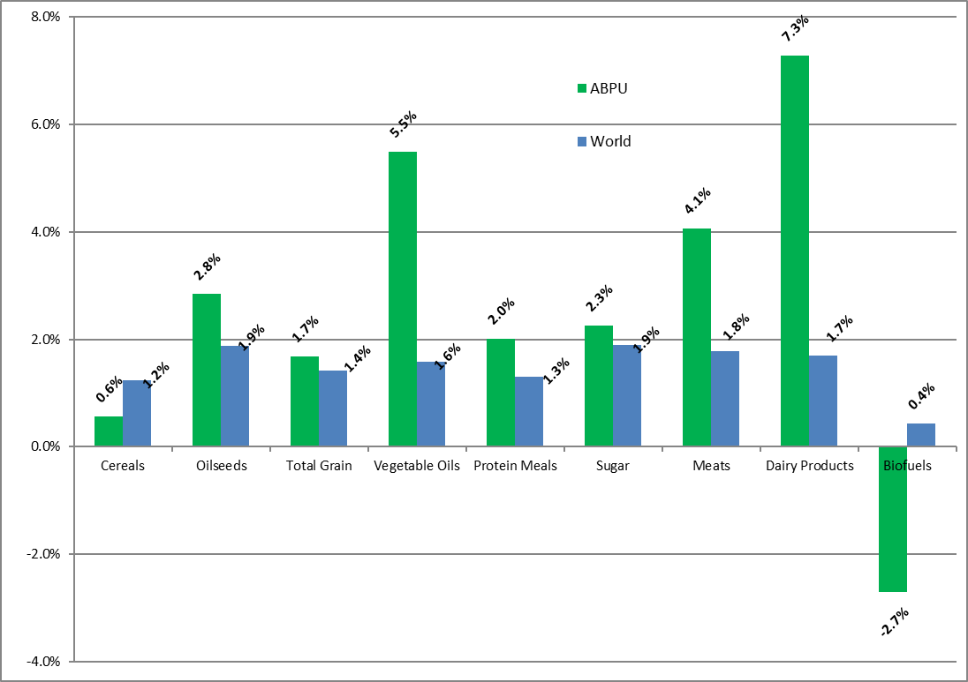
TOTAL WORLD AND ABPU COUNTRIES TRADE PROJECTIONS.
SELECTED PRODUCTS . 2015-2024
(annual growth rates in %)
Source: FAO-OCDE Outlook; INAI
Notes:
7
7
7
It covers practically 2/3 of the region´s land area.
Its GDP is just under u$s 800 billion - 53% of the regions total.
Its total trade (exports plus imports) reached 146 billion dollars in 1995.
65% of U.S. foreign direct investment in South America is in the MS countries. Brazil is the largest recipient of U.S. FDI in L.A. (including Mexico). Brazil u$s 19,0 billion and Mexico u$s 16,3 billion (1994 figures).
In other words, Mercosur is an integrated market which accounts for more than half the value of Latin America´s main economic indicators, and has a unmistakable potential and drawing power.
Chile has just concluded a Free Trade Agreement with MS, which will open further avenues for growth in trade and investments.

Slide 7
ABPU COUNTRIES’ NET EXPORTS AND EXPORT SHARES. SELECTED PRODUCTS 2015 & 2024
(million tons and %)
Products* |  | Net Exports |  |  |  | World Exports Share |  |  |  | Share Growth
 |  | (million ton) |  |  |  | (%) |  |  |  | (%)
 |  | 2015 |  | 2024 |  | 2015 |  | 2024 |  | 2015-2024
 |  | A |  | B |  | C |  | D |  | ((D-C)/C)
Cereals |  | 72,5 |  | 76,2 |  | 20,0% |  | 18,5% |  | -7,09%
Oilseeds |  | 69,2 |  | 91,8 |  | 47,0% |  | 51,8% |  | 10,27%
Total Grain |  | 141,7 |  | 168,0 |  | 27,7% |  | 28,6% |  | 2,96%
Vegetable Oils |  | 7,7 |  | 13,5 |  | 9,9% |  | 15,0% |  | 50,51%
Protein Meals |  | 48,9 |  | 59,8 |  | 57,3% |  | 61,4% |  | 7,24%
Sugar |  | 23,3 |  | 29,1 |  | 40,7% |  | 42,2% |  | 3,73%
Meats |  | 7,8 |  | 11,7 |  | 24,7% |  | 31,0% |  | 25,56%
Dairy Products |  | 0,3 |  | 0,7 |  | 3,9% |  | 7,5% |  | 92,36%
Biofuels** |  | 1,6 |  | 1,6 |  | 16,2% |  | 15,6% |  | -3,95%
Source: FAO-OCDE Outoook; INAI.
Notes * Products as specified in FAO-OCDE Outoook ; ** Thousand of million litres
Notes:
7
7
7
It covers practically 2/3 of the region´s land area.
Its GDP is just under u$s 800 billion - 53% of the regions total.
Its total trade (exports plus imports) reached 146 billion dollars in 1995.
65% of U.S. foreign direct investment in South America is in the MS countries. Brazil is the largest recipient of U.S. FDI in L.A. (including Mexico). Brazil u$s 19,0 billion and Mexico u$s 16,3 billion (1994 figures).
In other words, Mercosur is an integrated market which accounts for more than half the value of Latin America´s main economic indicators, and has a unmistakable potential and drawing power.
Chile has just concluded a Free Trade Agreement with MS, which will open further avenues for growth in trade and investments.

Slide 8
World & ABPU+US. Maize Production (Tonnes)
Source: Prepared by author with data from USDA Custom Query

Slide 9
World & ABPU+US. Maize Exports (Tonnes)
Source: Prepared by author with data from USDA Custom Query

Slide 10
World & ABPU+US. Maize Harvested Area (Has)
Source: Prepared by author with data from USDA Custom Query

Slide 11
World & ABPU+US. Maize Yield (Tonne/Ha)
Source: Prepared by author with data from USDA Custom Query

Slide 12
The multilateral trading System
1947 Foundation of GATT (General Agreement on Tariffs and Trade)
1973-79 Tokyo Round. Tariff decrease & agreements to transform non-tariff barriers to tariffs and limit safeguards. (Ag trade excluded)
1986-94 Uruguay Round. Ag Trade negotiations begin.
Foundation of WTO OMC. 1-1-1995. Strong dispute settlement. Ag Agreement: SPS, TBT, etc.
2001 Doha Round: Ag: Tariffs, domestic support or subsidies, export subsidies banned in Nairobi, Market Access, TBT, SPS.
Trade barriers must be transparent. Based on tariffs or science. Related to good’s properties or measurable risks.

Slide 13



Climate agenda and impact on trade
1992 (COP 1) Climate World Summit. Eco92 Río de Janeiro
  Precautionary Principle as trade barrier.
1996 IPCC Guidelines.
  Overestimation of crops GHG Emissions. (Arg. 100% overestimation in crops emissions)
  Carbon footprints based on them.
1997: Kyoto Protocol (effective in 2005)
2006 IPCC Guidelines.
ILUC: models that predict future emissions as barriers to trade.
2015 (COP 21): Paris Accord & 2030 Agenda SDGs: Market Based Mechanisms & Soils become part of the solution

Slide 14
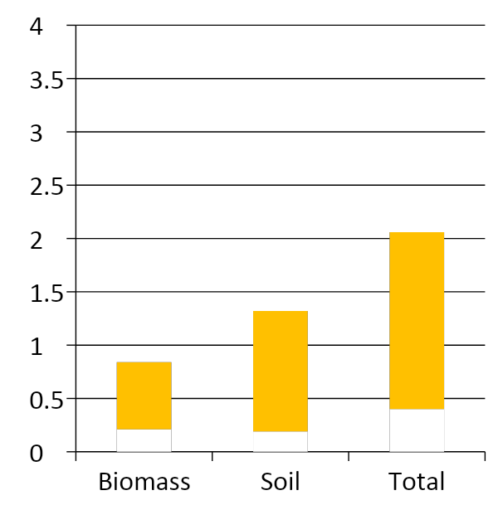
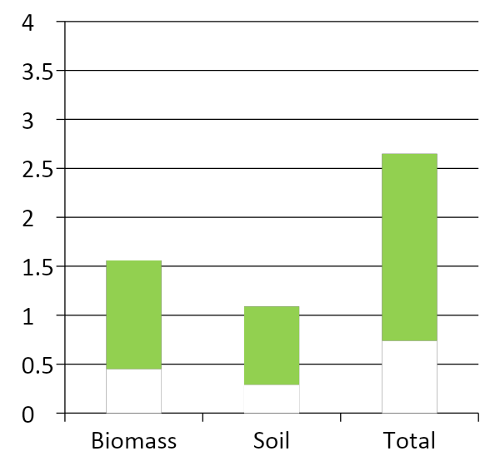
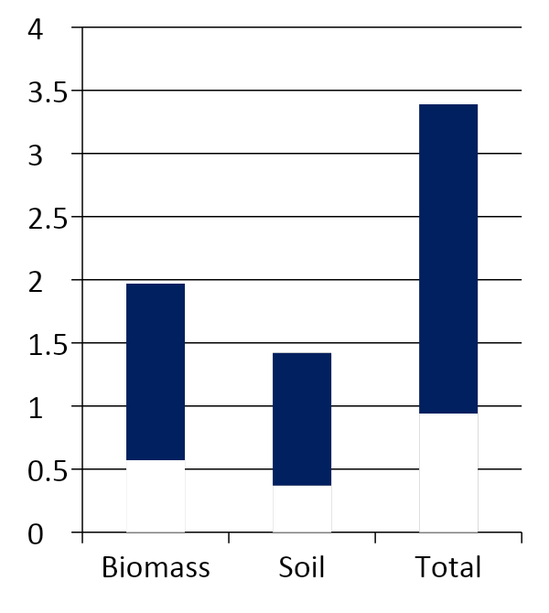
Global Soil Ecosystems Carbon sequestration capacity
Global soils sequestration capacity: 2-8 GTons de CO2 eq/year (croplands + grasslands+ forests)
Grasslands, Steppes, rangelands
Forests, Woodlands
Croplands
Sequestration Potential
Gigatons C/.y⁻¹
Target area = 1,472 Million ha
Target area = 3,323 Million ha
Target area = 1,305 Million ha
Source; Adapted by Carbon Group- Agroclimatic Solutions from P.Smith et al. 2014, Lal et al. 2018

Slide 15
Market based mechanisms & carbon price
There is consensus amongst countries, multilateral organizations, public and private sector that carbon pricing is beneficial:
  Favors investments in sectors that mitigate GHG emissions or capture C.
  Promotes technological innovation and investments.
  GHG mitigation is done at the least possible cost.
  Generates resources that Governments can use to compensate market inefficiencies.
Price of carbon must be significant to be effective.
Article 6 of the Paris Accord will create the Sustainable Development Mechanism and allow trading of ITMOs (Internationally Traded Mitigation Outcomes).

Slide 16
Conclusions
Food security demands clear, transparent and predictable trading rules.
Southern Cone countries have implemented an intensification strategy increasing production and sustainability.
The Multilateral Trading System and the Climate Agenda are under great pressure, they both require strong commitments and the defense of science based methodologies.
Market based mechanisms and carbon pricing promote the necessary investments to achieve a low carbon global economy.
The foundational principles of the WTO, the UNFCCC and the IPCC must be guarded as beacons that lead the way to solve the climate and sustainable development challenges humanity faces today.

Slide 17


Thank you,
Muito obrigado,
Muchas gracias
Martín Fraguío:
Mobile: +54911 5602 3272
mfraguio@carbongroup.com.ar

